Slide 1
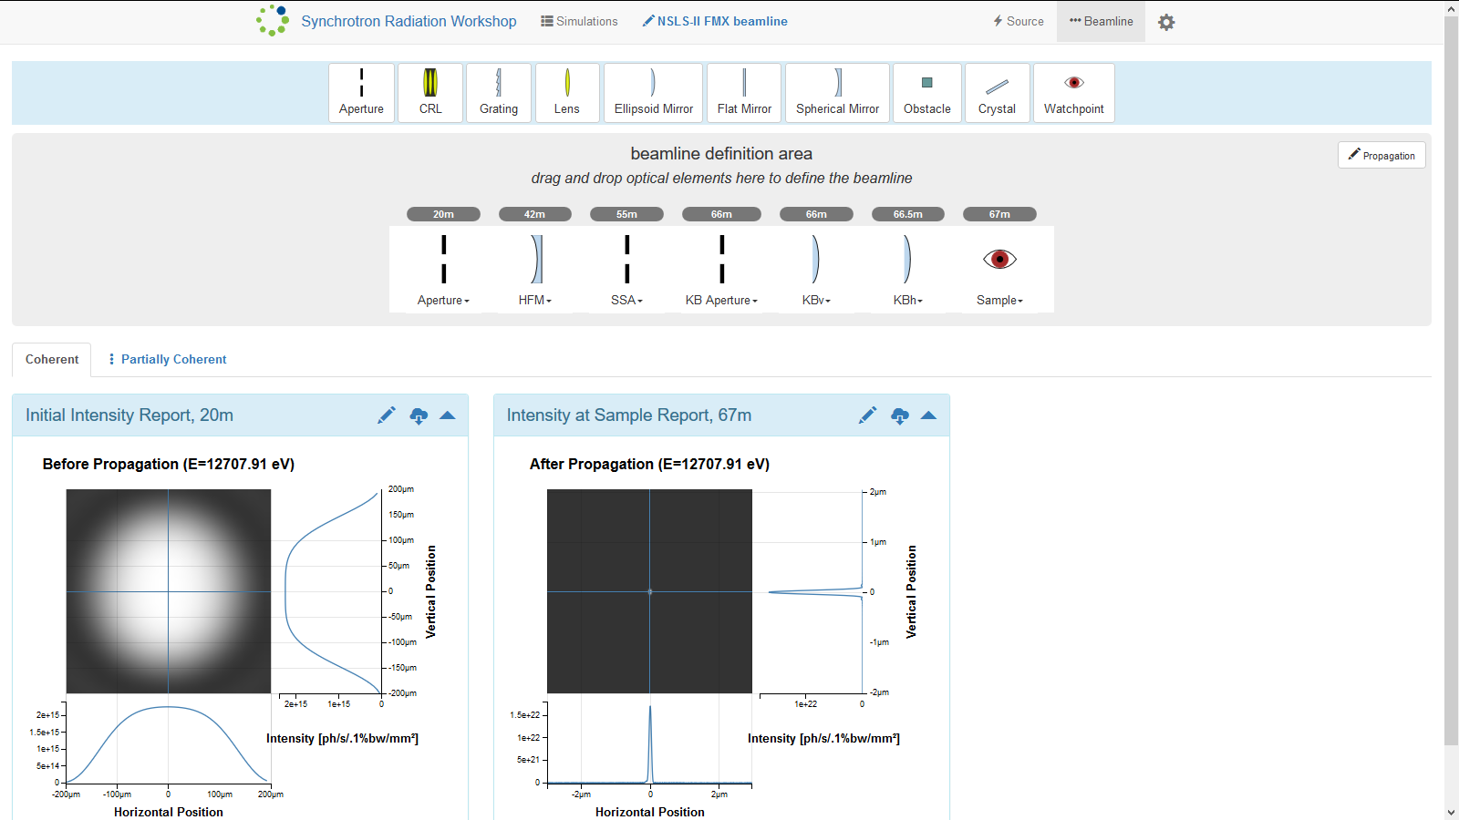
Using and Testing Synchrotron Radiation Simulation Software, SRW, and its Web-interface, Sirepo.
What is srw?
Helping make sirepo better
Investigating performance issues in sirepo
SRW, Synchrotron Radiation Workshop, is a computer software solution used to simulate synchrotron radiation (radiation produced by synchrotron particle accelerators, such as the NSLS-II) and its propagation though beamlines – systems of optical devices used to manipulate synchrotron radiation to, for example, focus or monochromatize it, making it applicable for a particular use.
Much of the useful radiation produced by synchrotron light sources is X-ray. Due to vast differences in optical properties between visible and X-ray radiation, optical systems designed for visible light are not applicable for X-rays. Instead, X-ray specific optical systems are designed. X-ray optics is much more complex than visible light optics, both in the necessary calculations and the optical devices in use, and SRW can assist beamline design by taking on some of the calculations, to simulate the outcomes of propagation of X-rays through various configurations of virtual beamlines (computer models of beamlines.)
cvvvvvvvvv
What is sirepo?
Sirepo is a web-based SRW interface that allows users to set up, initiate, and access the results of, SRW simulations running on remote servers, requiring no familiarity with any programming language. Instead, Sirepo provides a means to create virtual beamlines and configure their simulations using a relatively simple graphic user interface.
Below is a screenshot of the Sirepo web interface. The beamline can be set up by drag-and-dropping optical elements and configuring them via their interactive pop-up menus (For many elements, the software calculates or otherwise obtains many parameters for the optical elements based on few parameters provided by user. For example, it can configure a focusing mirror based on the distance from source and the distance to the desired focal point, which are entered by user.)
Reporting bugs in sirepo
Testing
How Did I Use sirepo?
conclusions

